Slide 1

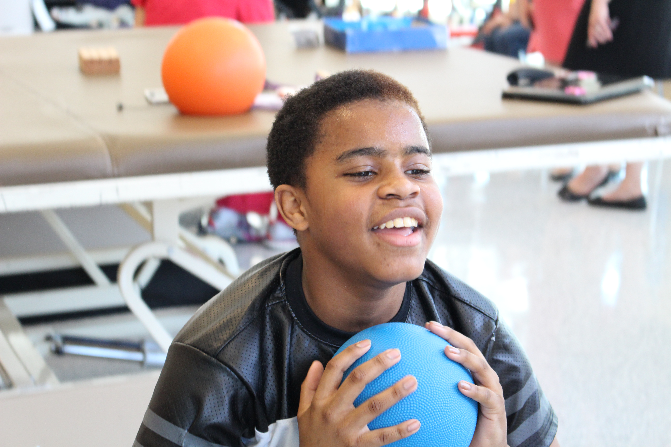

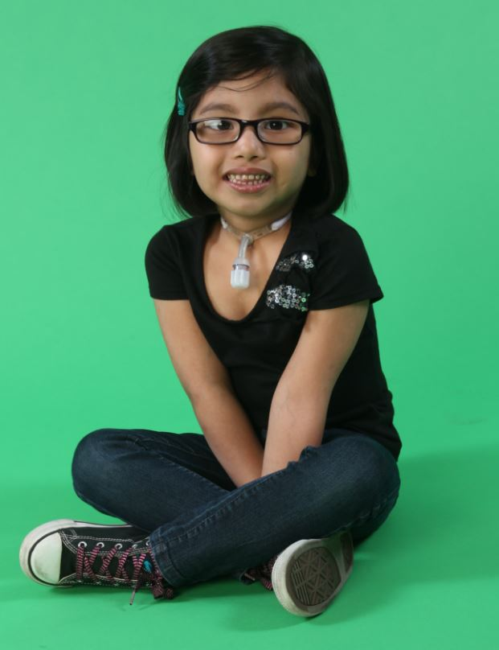
Children’s
Specialized Hospital
Hamilton Outpatient Center
Special Needs Primary Care and Physiatry

Slide 2
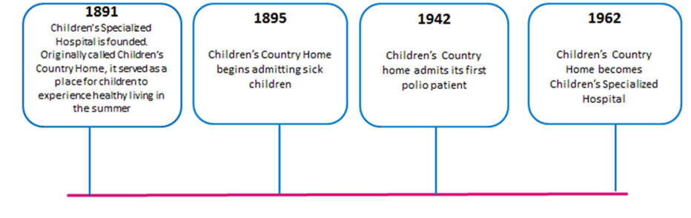
Celebrating 125 Years of Service
CSH has 68 inpatient beds, 72 long term care beds, 12 outpatient sites and will treat over 30,000 children this year
Notes:
2

Slide 3
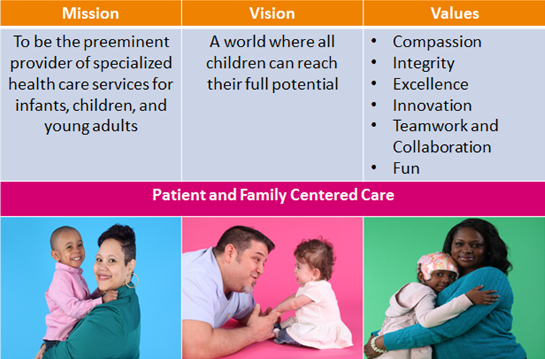
Culture at CSH
Notes:
3

Slide 4



Our Unique Difference
  Recipient of Microsoft Corp.’s 2015 Health Innovation Awards Patient Engagement category
  Named “2014 Top Children’s Hospital” by the Leapfrog Group
  Twenty-five of Children’s Specialized Hospital’s clinical team including physicians, therapists, psychologists and others were selected as “2014 New Jersey’s Favorite Kids Docs” by parents by NJ Family magazine
  Named among Top Children’s Hospitals, New York Magazine
  Named among Best Places to Work in NJ, NJ Biz
  Named “Hospital of the Year,” NJ Biz 2012
Notes:
4

Slide 5
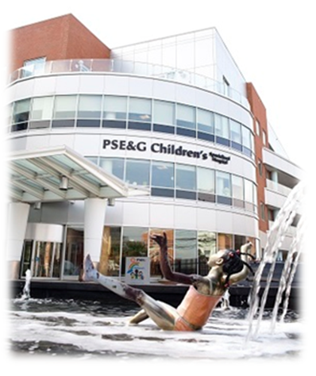
Services and Programs
Inpatient Programs
  Burn and Wound Care
  Post-NICU Infant Rehabilitation
  Post-Surgical Orthopedics
  Infant and Toddler Rehabilitation
  Chronic Illness Management
  Brain Injury
  Multi Complicated Trauma
  Neuromuscular and Genetic Disorders
  Spinal Cord Injury
  Chronic Pain Management

Slide 6
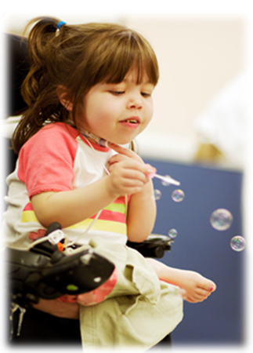
Services and Programs
Outpatient Services
  Audiology
  Autism
  Brian Injury
  Comprehensive Feeding
  Early Intervention
  Infant Developmental Follow-Up
  Occupational Therapy
  Physical Therapy
  Psychology
  Rehabilitation Technology
  Special Needs Primary Care
  Speech/ Feeding Therapy

Slide 7
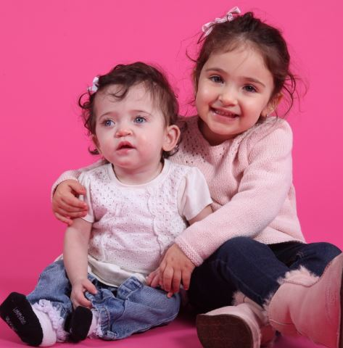
Services and Programs
Physician Specialties
  Developmental & Behavioral
  Neurology
  Physiatry
  Psychiatry
  Other

Slide 8
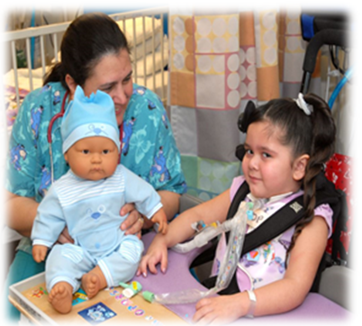
Services and Programs
Other
  Pediatric Long Term Care
  Early Developmental Screenings
  Project ECHO
  Community Based Recreation
  Camps and Workshops
  Peer Mentoring

Slide 9
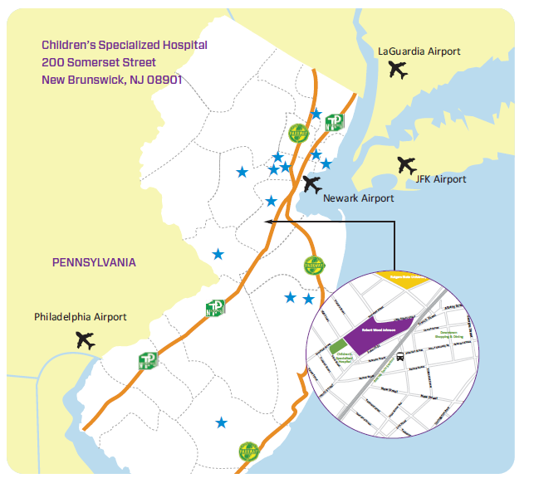
Locations
Bayonne
Clifton
East Brunswick
Egg Harbor
Hamilton
Mountainside
Newark
New Brunswick (2 locations)
Roselle Park
Toms River (2 locations)
Warren
13 Convenient Locations

Slide 10
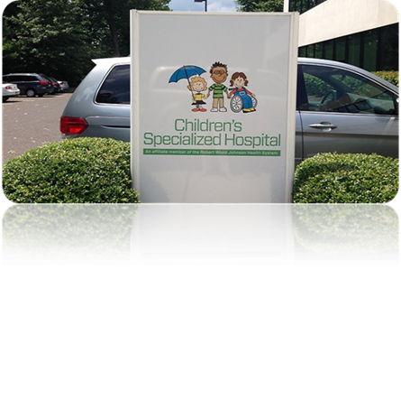
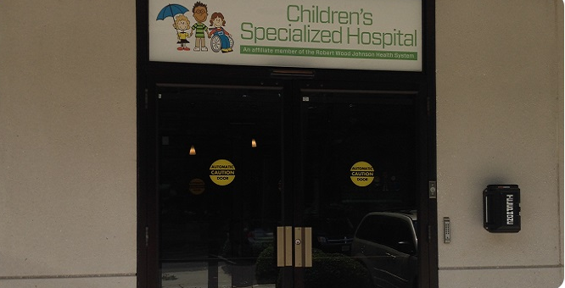
Children’s Specialized Hospital in Hamilton, NJ

Slide 11
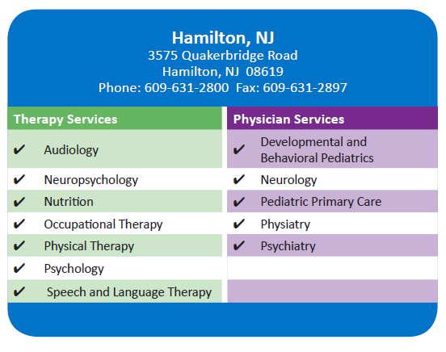
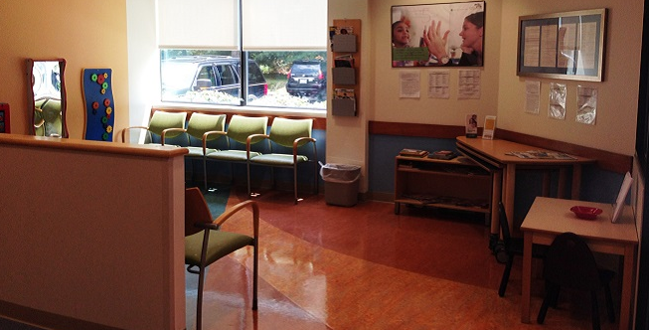
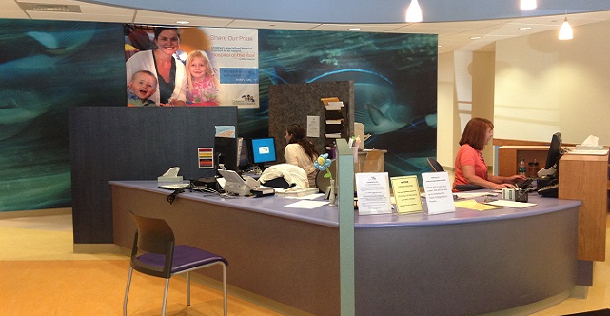
Programs and Services in Hamilton

Slide 12
Special Needs Primary Care Practice (SNPC)
With locations in Hamilton and Mountainside

Slide 13
SNPCP: Who do we see?
At our practice, we're your partner in providing primary care for children through the age of 21 with special healthcare needs and their siblings. Those eligible for the practice include but are not limited to children with:
Technology dependence
Down syndrome
Prematurity
Autism
Cerebral Palsy
Metabolic disease
Poorly controlled chronic illness
Genetic Disorders
Rare Diseases
Developmental Delays

Slide 14
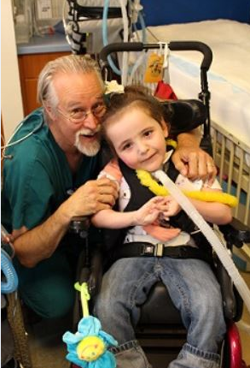
SNPCP: What do we do?
In addition to supporting well visits, vaccines, follow up visits and sick visits, our team is trained and equipped to manage the care and delivery of resources necessary to improve the health outcomes of children that are fragile, at-risk and/or living with medical complexities.
Notes:
14

Slide 15

SNPCP: Who are we?
Our multidisciplinary team includes…
  Doctors
  Care Coordinators
  Social Workers
  APN
  Nurses

Slide 16
SNPCP: Why we do it
Our care team’s goal is to provide focused, coordinated care, in collaborations with patient families so that all children can meet their full potential despite their diagnosis or environmental barriers

Slide 17

SNPC: How to refer
Hamilton Office
3575 Quakerbridge Road
Hamilton, NJ 08619
(609) 631-2811

Slide 18
Physiatry- Physical Medicine and Rehabilitation Services
With increased availability in Hamilton and Toms River

Slide 19
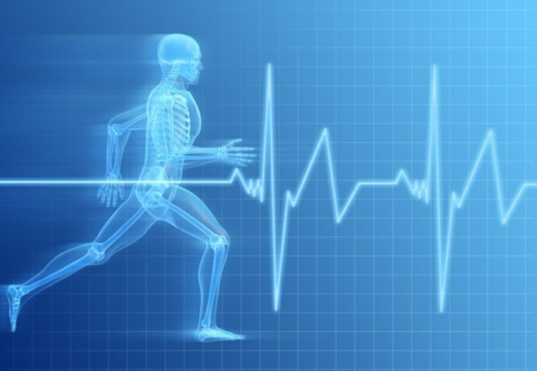
Physiatry Overview
Specialist in muscle, bone, and nerve disorders such as cerebral palsy, brain injuries, spinal cord injuries, neuromuscular disorders, and musculoskeletal conditions
Provide spasticity management for cerebral palsy patients and other patients with spasticity
Prescribes rehabilitation technology (wheelchairs, prosthetics, braces, ect.)

Slide 20
Conditions Treated
Cerebral palsy
Brain injuries
Spinal cord injuries
Neuromuscular disorders
Musculoskeletal conditions
Developmental Delays
Down Syndrome
Autism Spectrum Disorder
Sensory Integration Disorder
Genetic Disorders leading to nerve/muscle/bone problems

Slide 21
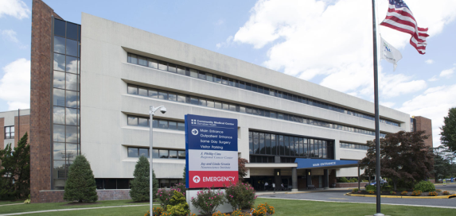

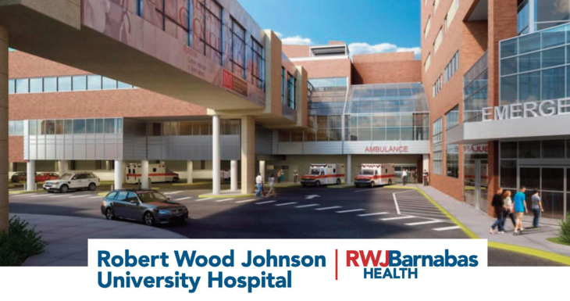
Procedures Performed
Botox Injections at Community Medical Center (Toms River) & Robert Wood Johnson University Hospital (New Brunswick) for…
  Spasticity management
  Painful muscles
  Toe walking
  Excessive drooling
  Open mouth posture
  Teeth grinding and TMJ dysfunction

Slide 22
Reasons to Refer
Cerebral palsy, spinal cord injury, spina bifida or brain injury
Spasticity, hypotonia, dystonia
Abnormal gait, such as toe-walking
Developmental delay
Genetic disorders
Weakness or impaired balance
Difficulties with mobility or other activities of daily living
Bracing, wheelchair, or equipment needs
Excessive drooling, jaw clenched/severe lip biting, open mouth posture
Neuropathic pain
Patients with sensory processing difficulties
Patients with musculoskeletal pain (back pain, ankle sprain, leg pain etc.) who are not surgical candidates or need management post-surgery
Chronic pain including suspected psychosomatic pain
Limited range of motion
Therapy needs

Slide 23
How to Make an Appointment
Have families calls
1-888-244-5373

Slide 24

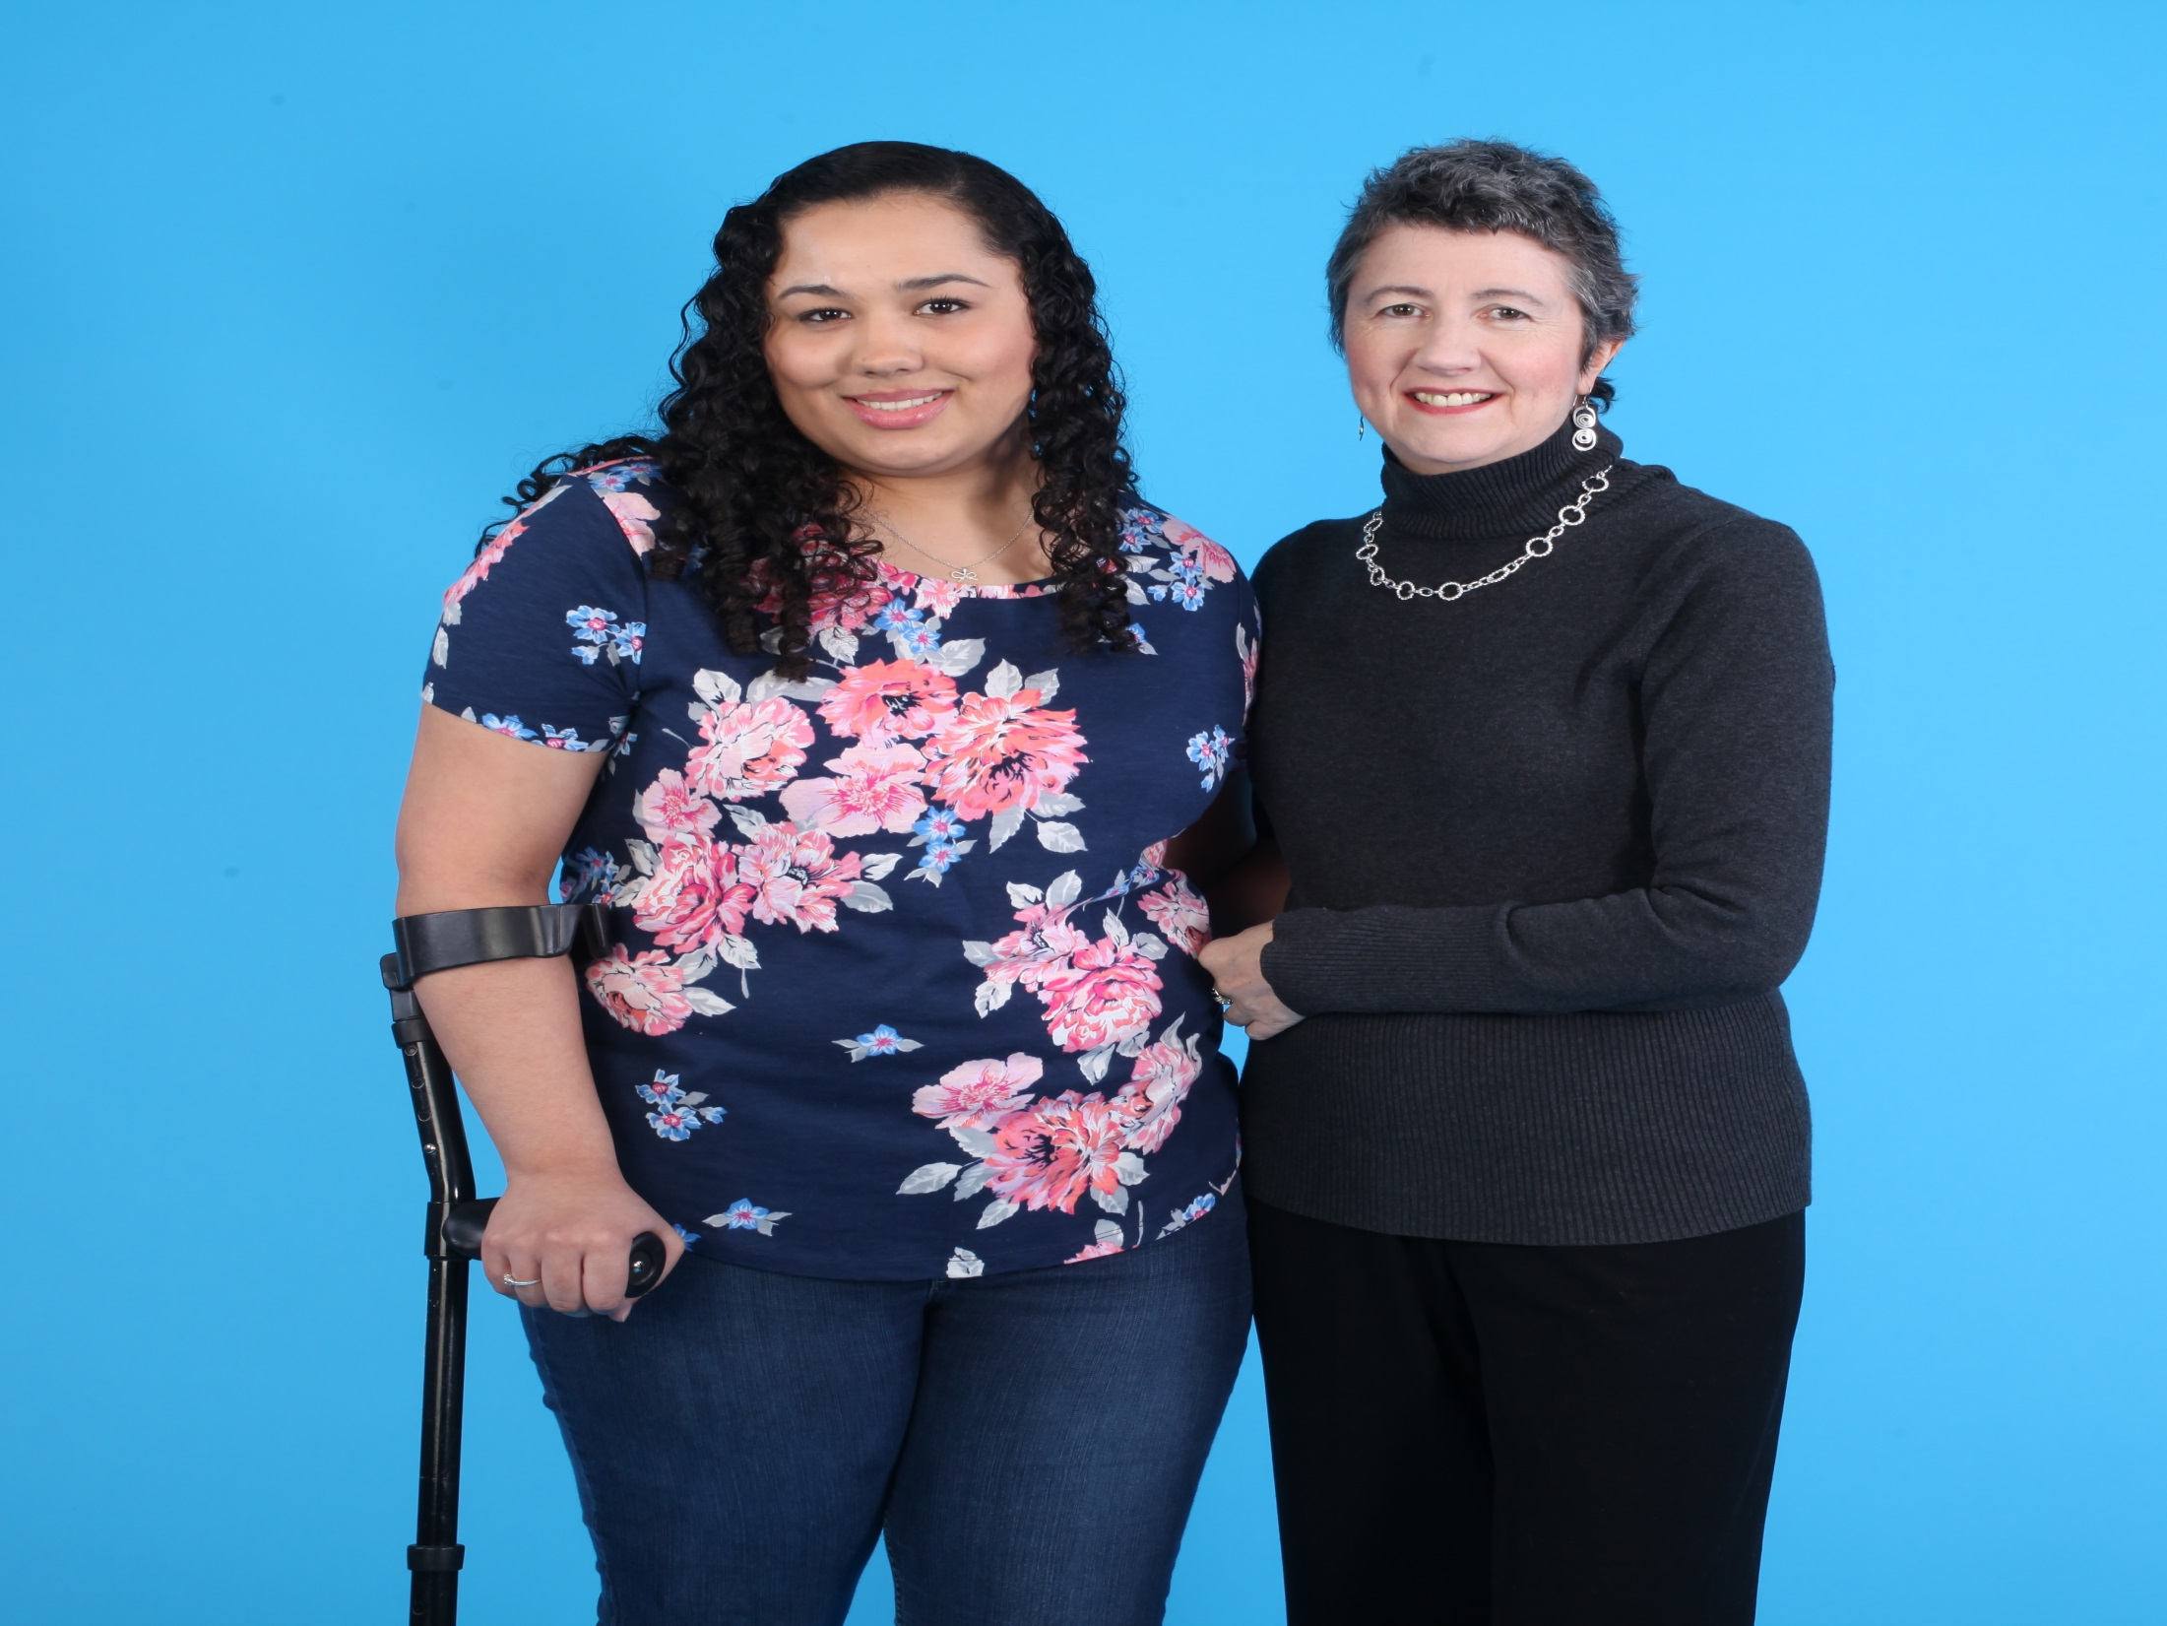
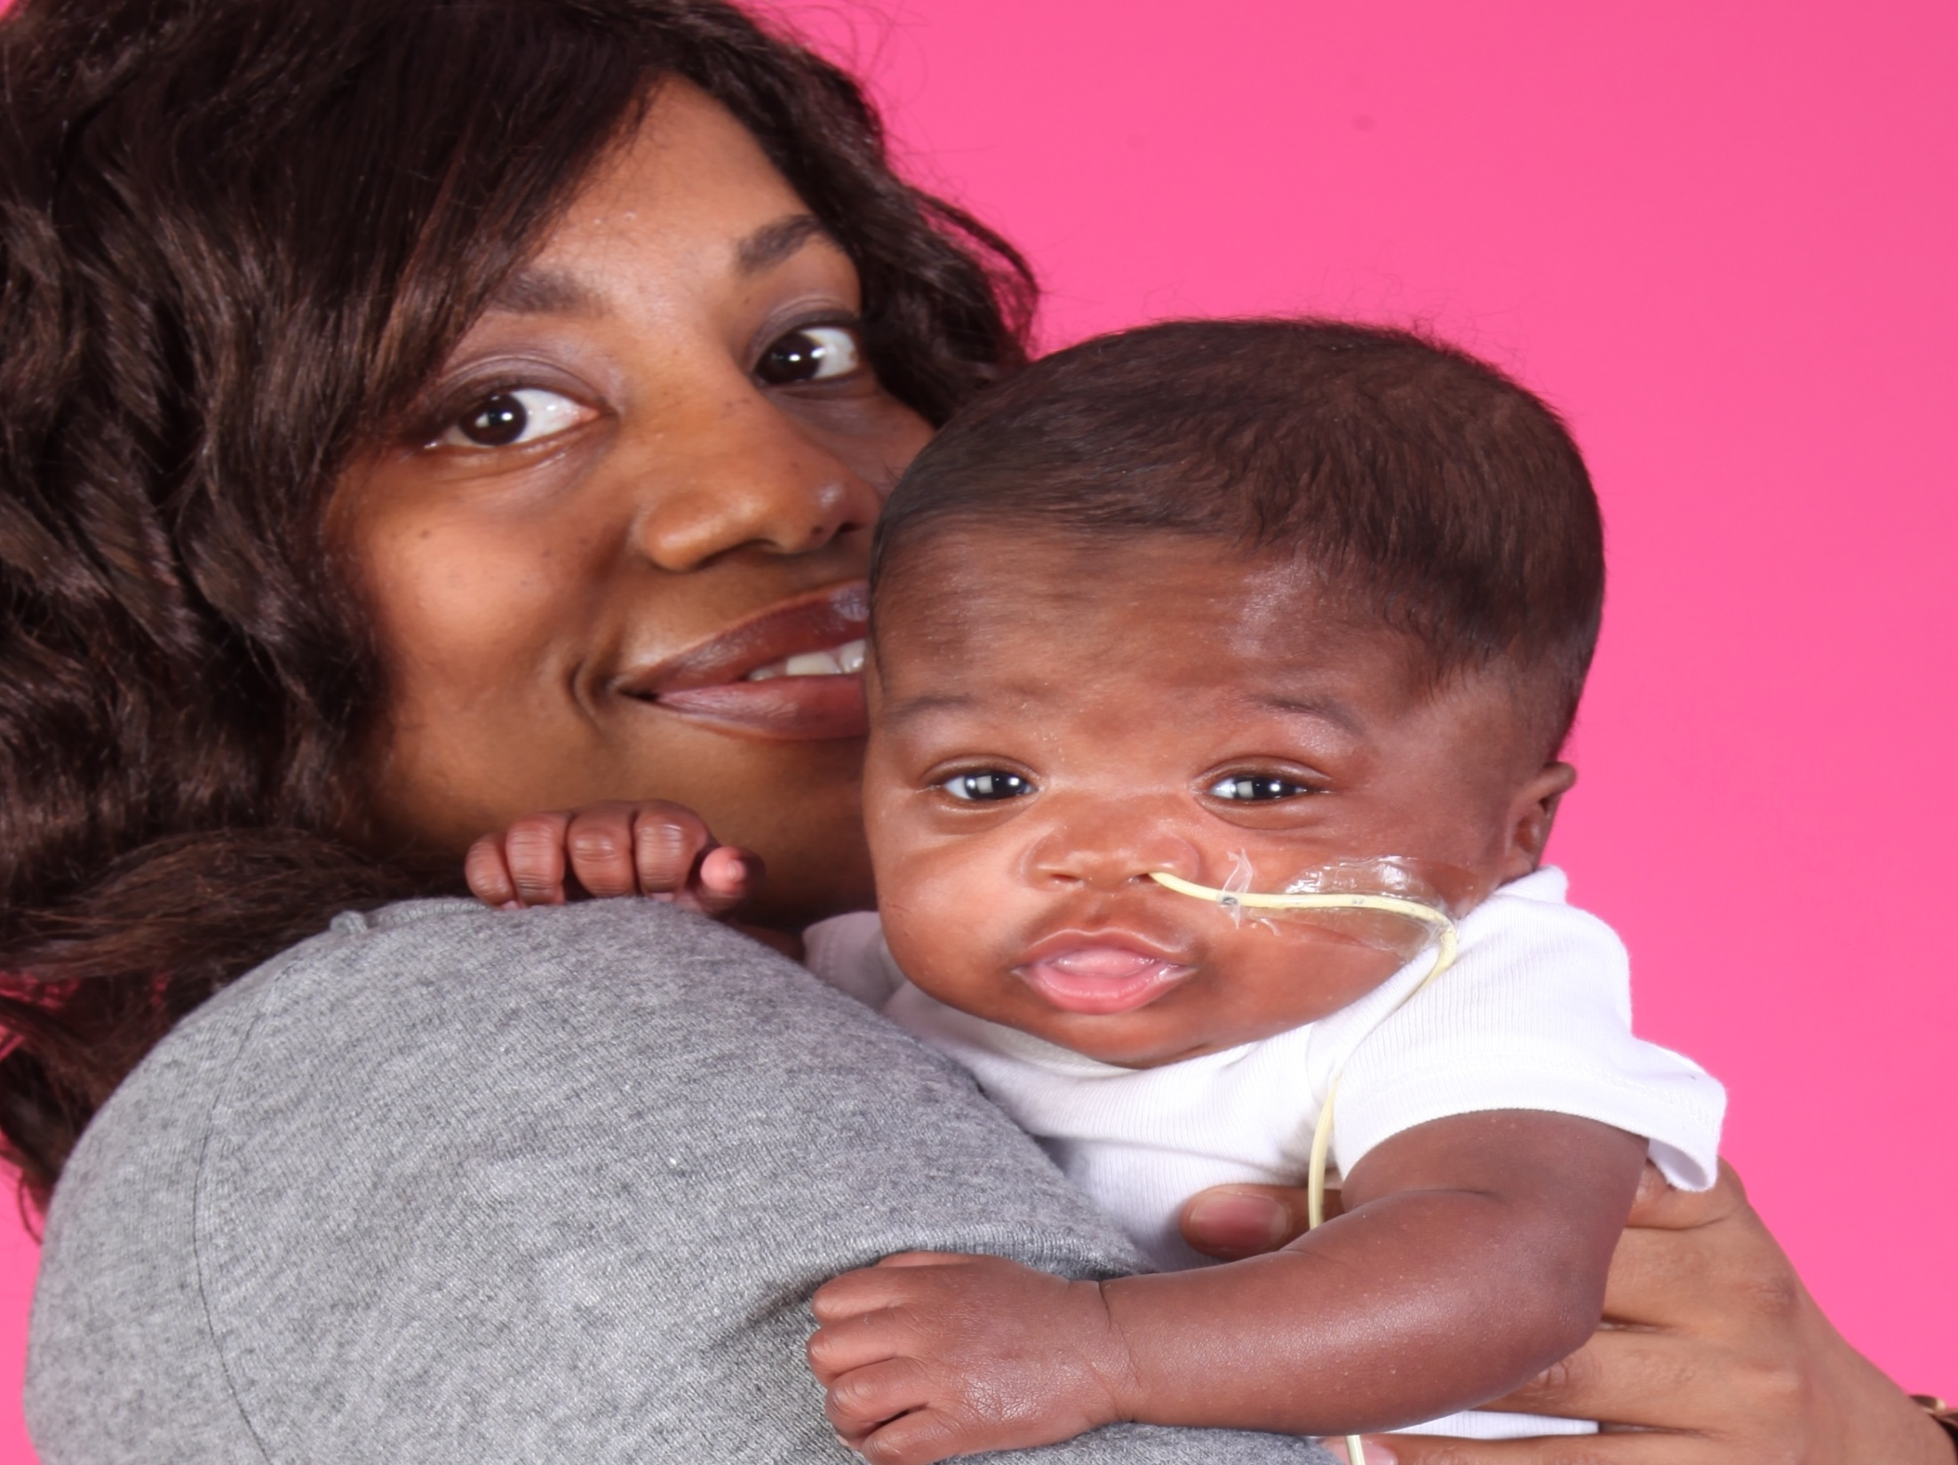
Children’s Specialized Hospital
Thank you for your time!

